Slide 2
Price List
Added Features
Datasheet Download For:
  Single product
  Complete BOQ
Weight and Volume Estimation

Slide 3
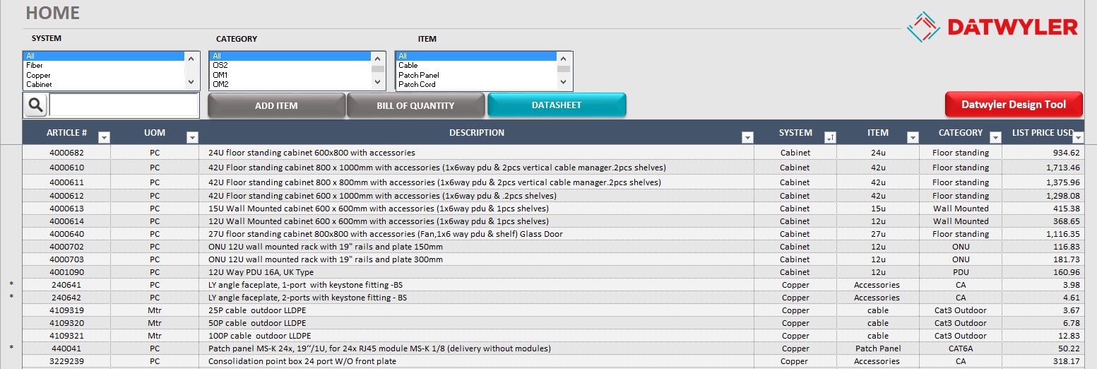
Price List
Screen View
Filter Product by Category
Download Datasheet
New Function
Search by Article Number
Stock Available Products

Slide 4
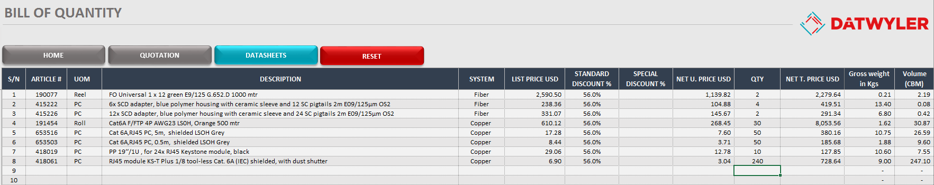
Bill of Quantities
Screen View
Download Datasheet
New Function
Weight and Volume Estimation
New Function

Slide 5
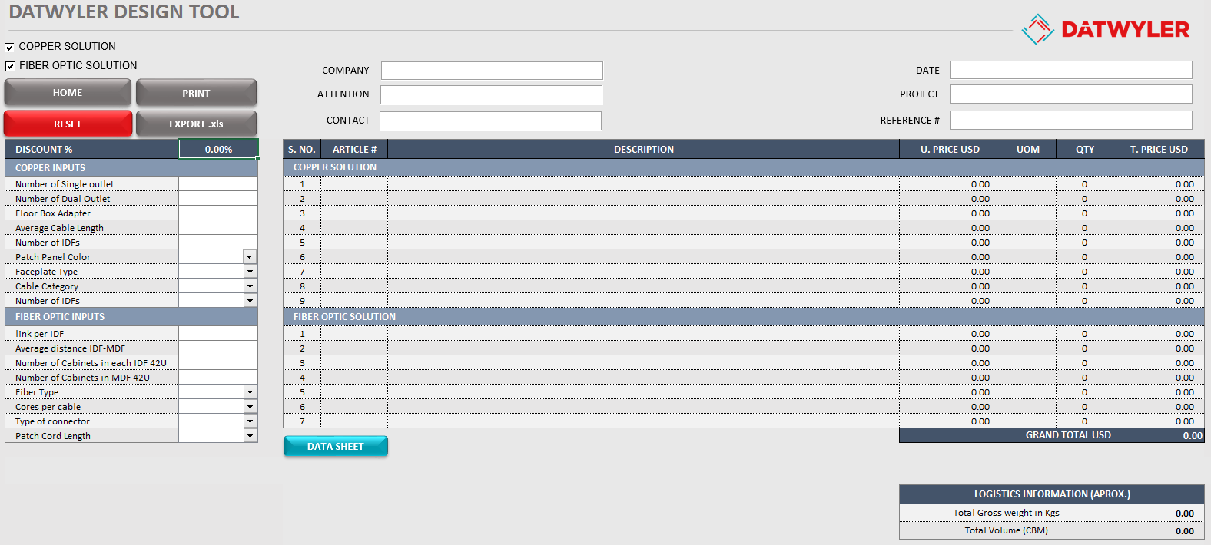
Datwyler Design Tool
Input Basic Information
Output Complete Information
Article Number
Discerption
Unit Price
Unit of measurement
Quantity
Total Price
Download Datasheets
New Function
Weight and Volume Estimation
New Function

Slide 6
Hands On
Price List & Design Tool

